Slide 1
Chapter 4: Routing Concepts
Routing Protocols
Notes:
Cisco Networking Academy program
Routing Protocols
Chapter 4: Routing Concepts

Slide 2
Chapter 4
4.0 Routing Concepts
4.1 Initial Configuration of a Router
4.2 Routing Decisions
4.3 Routing Operation
4.4 Summary
Notes:
Chapter 9

Slide 3
Chapter 4: Objectives
Configure a router to route between multiple directly connected networks
Describe the primary functions and features of a router.
Explain how routers use information in data packets to make forwarding decisions in a small to medium-sized business network.
Explain the encapsulation and de-encapsulation process used by routers when switching packets between interfaces
Compare ways in which a router builds a routing table when operating in a small to medium-sized business network.
Explain routing table entries for directly connected networks.
Explain how a router builds a routing table of directly connected networks.
Notes:
4.

Slide 4
Chapter 4: Objectives (continued)
Explain how a router builds a routing table using static routes.
Explain how a router builds a routing table using a dynamic routing protocol.
Notes:
4.

Slide 5
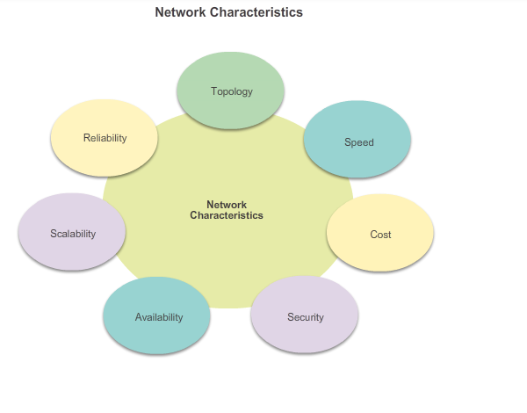
Functions of a Router Characteristics of a Network
Notes:
4.1 Initial Router Configuration
4.1.1 Function of a Router
4.1.1.1 Characteristics of a Network

Slide 6
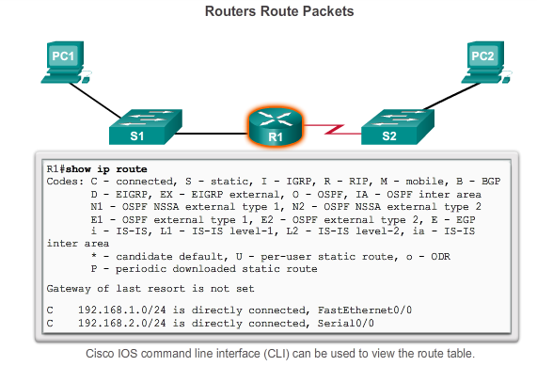
Functions of a Router Why Routing?
The router is responsible for the routing of traffic between networks.
Notes:
Function of a Router
4.1.1.2 Why Routing?

Slide 7
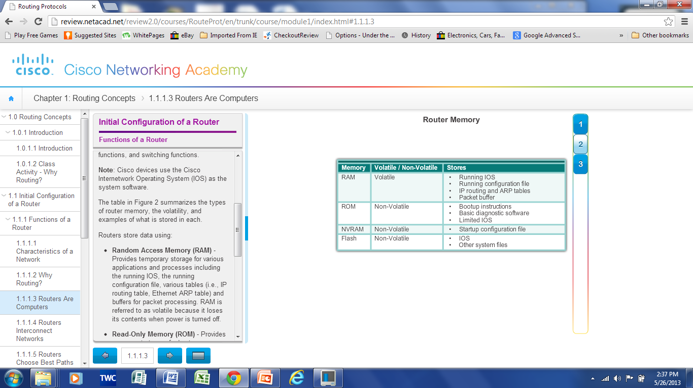
Functions of a Router Routers are Computers
Routers are specialized computers containing the following required components to operate:
Central processing unit (CPU)
Operating system (OS) - Routers use Cisco IOS
Memory and storage (RAM, ROM, NVRAM, Flash, hard drive)
Routers utilize the following memory:
Notes:
Functions of a Router
4.1.1.3 Routers are Computers

Slide 8
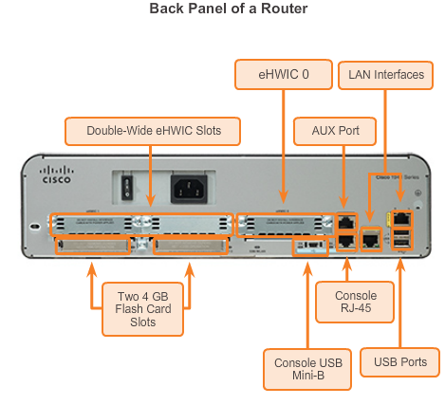
Functions of a Router Routers are Computers
Routers use specialized ports and network interface cards to interconnect to other networks
Notes:
Functions of a Router
4.1.1.3 Routers are Computers

Slide 9
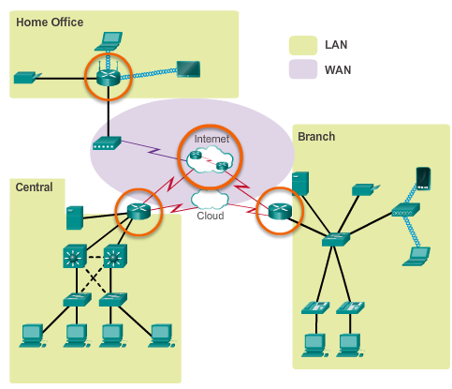
Functions of a Router Routers Interconnect Networks
Routers can connect multiple networks.
Routers have multiple interfaces, each on a different IP network.
Notes:
Functions of a Router
4.1.1.4 Routers Interconnect Networks

Slide 10
Functions of a Router Routers Choose Best Paths
Determine the best path to send packets
Uses its routing table to determine path
Forward packets toward their destination
Forwards packet to interface indicated in routing table.
Encapsulates the packet and forwards out toward destination.
Routers use static routes and dynamic routing protocols to learn about remote networks and build their routing tables.
Notes:
Functions of a Router
4.1.1.5 Routers Choose Best Paths

Slide 11
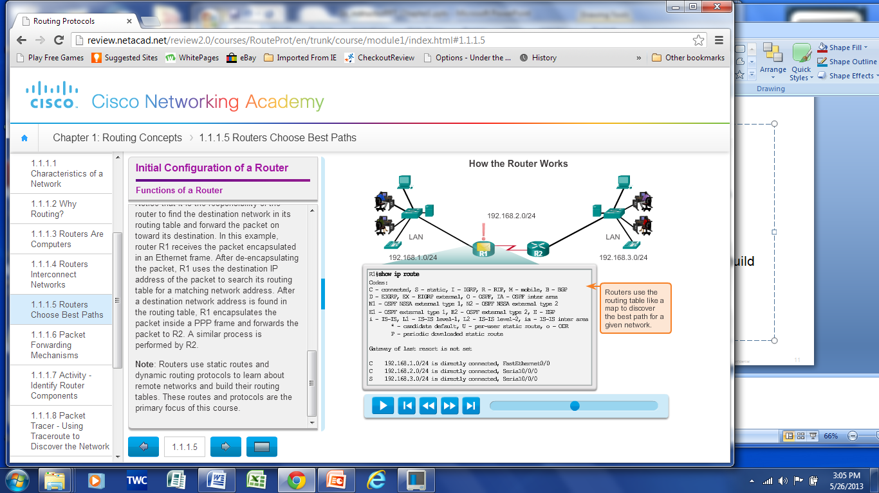
Functions of a Router Routers Choose Best Paths
Notes:
Functions of a Router
4.1.1.5 Routers Choose Best Paths

Slide 12
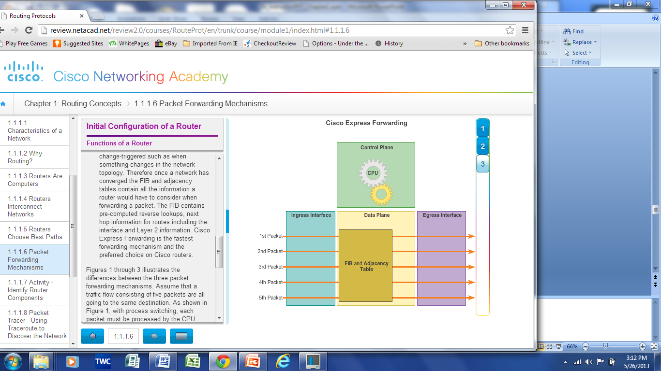
Functions of a Router Packet Forwarding Methods
Process switching – An older packet forwarding mechanism still available for Cisco routers.
Fast switching – A common packet forwarding mechanism which uses a fast-switching cache to store next hop information.
Cisco Express Forwarding (CEF) – The most recent, fastest, and preferred Cisco IOS packet-forwarding mechanism. Table entries are not packet-triggered like fast switching but change-triggered.
Notes:
Functions of a Router
4.1.1.6 Packet Forwarding Methods
4.1.1.7 Activity – Identify Router Components
4.1.1.8 Packet Tracer – Using Traceroute to Discover Networks
4.1.1.9 Lab – Mapping the Internet

Slide 13
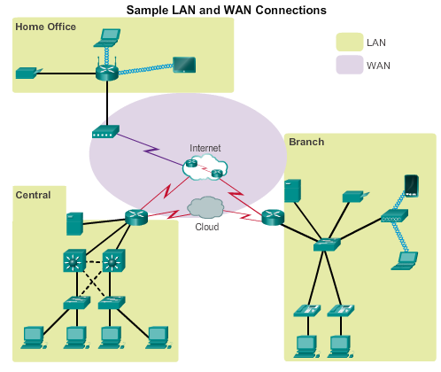
Connect Devices Connect to a Network
Notes:
4.1.2 Connect Devices
4.1.2.1 Connect to a Network

Slide 14
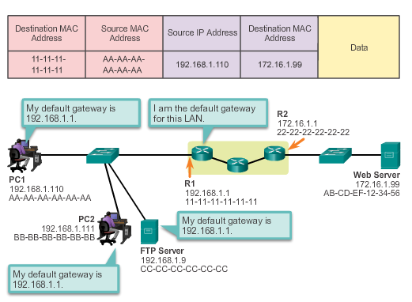
Connect Devices Default Gateways
To enable network access devices must be configured with the following IP address information
IP address - Identifies a unique host on a local network.
Subnet mask - Identifies the host’s network subnet.
Default gateway - Identifies the router a packet is sent to to when the destination is not on the same local network subnet.
Notes:
4.1.2 Connect Devices
4.1.2.2 Default Gateways

Slide 15
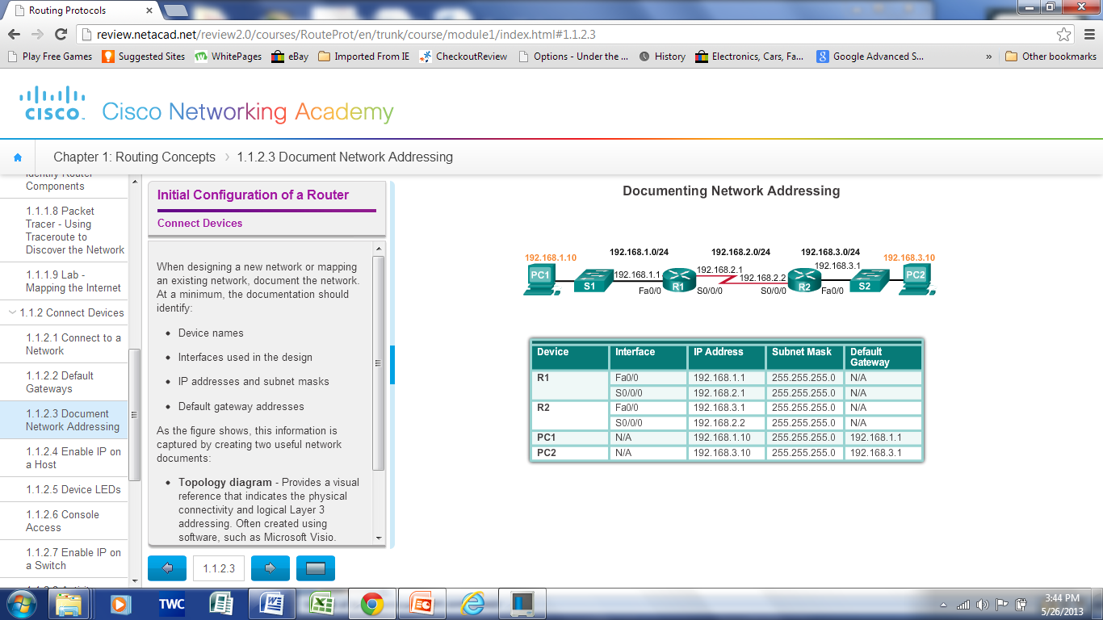
Connect Devices Document Network Addressing
Network Documentation should include at least the following in a topology diagram and addressing table:
Device names
Interfaces
IP addresses and
subnet mask
Default gateways
Notes:
4.1.2 Connect Devices
4.1.2.3 Document Network Addressing

Slide 16
Connect Devices Enable IP on a Host
Statically Assigned IP address – host is manually assigned the IP address, subnet mask and default gateway. DNS server IP address can also be assigned.
Used to identify specific network resources such as network servers and printers
Can be used in very small networks with few hosts.
Dynamically Assigned IP Address – IP Address information is dynamically assigned by a server using Dynamic Host Configuration Protocol (DHCP)
Most hosts acquire their IP address information through DHCP
DHCP services can be provided by Cisco routers
Notes:
4.1.2 Connect Devices
4.1.2.4 Enable IP on a Host

Slide 17
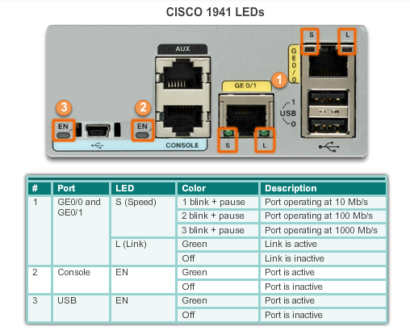
Connect Devices Device LEDs
Notes:
4.1.2 Connect Devices
4.1.2.5 Device LEDs

Slide 18
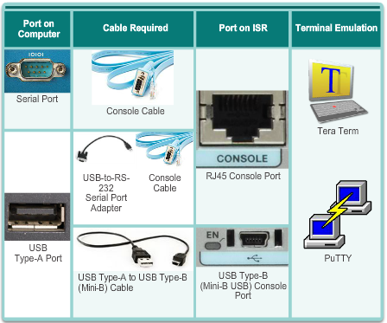
Connect Devices Console Access
Console access requires:
Console cable – RJ-45-to-DB-9 console cable
Terminal emulation software – Tera Term, PuTTY, HyperTerminal
Notes:
4.1.2 Connect Devices
4.1.2.6 Console Access

Slide 19
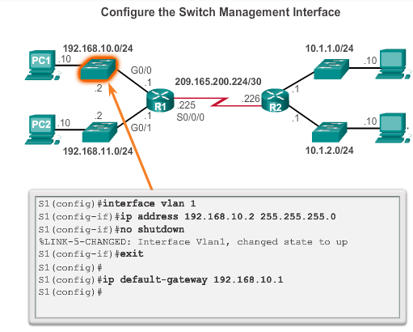
Connect Devices Enable IP on a Switch
Network infrastructure devices require IP addresses to enable remote management.
On a switch the management IP address is assigned on a virtual interface
Notes:
4.1.2 Connect Devices
4.1.2.7 Enable IP on a Switch
4.1.2.8 Activity – Document an Addressing Scheme
4.1.2.9 Packet Tracer – Documenting the Network

Slide 20
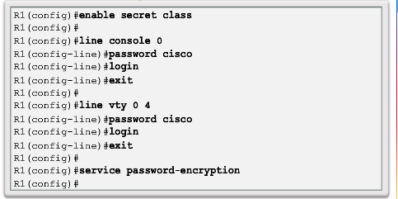
Basic Settings on a Router Configure Basic Router Settings
Basics tasks that should be first configured on a Cisco Router and Cisco Switch:
Name the device – Distinguishes it from other routers
Secure management access – Secures privileged EXEC, user EXEC, and Telnet access, and encrypts passwords to their highest level
Configure a banner – Provides legal notification of unauthorized access.
Notes:
4.1.3 Basic Settings on a Router
4.1.3.1 Configure Basic Router Settings

Slide 21
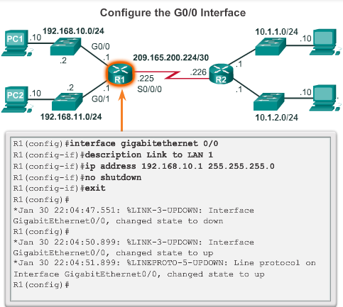
Basic Settings on a Router Configure Router Interfaces
To be available a router interface must be:
Configured with an address and subnet mask .
Activated – by default LAN and WAN interfaces are not activated. Must be activated using no shutdown command.
Other parameters - serial cable end labeled DCE must be configured with the clock rate command.
Optional description can be included.
Notes:
4.1.3 Basic Settings on a Router
4.1.3.3 Configure Router Interfaces

Slide 22
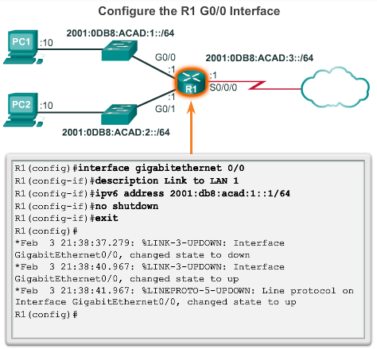
Basic Settings on a Router Configure an IPv6 Router Interface
Configure interface with IPv6 address and subnet mask. Use the ipv6 address ipv6-address/ipv6-length [link-local | eui-64]interface configuration command.
Activate – using no shutdown command.
IPv6 interfaces can support more than one address:
Configure a specified global unicast - ipv6-address /ipv6-length
Configure a global IPv6 address with an interface identifier (ID) in the low-order 64 bits - ipv6-address /ipv6-length eui-64
Configure a link-local address - ipv6-address /ipv6-length link-local
Notes:
4.1.3 Basic Settings on a Router
4.1.3.3 Configure an IPv6 Router Interface

Slide 23
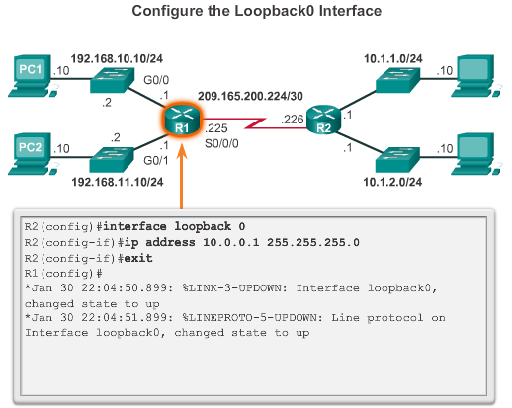
Basic Settings on a Router Configure a Loopback Interface
Loopback interface is a logical interface internal to the router.
It is not assigned to a physical port, it is considered a software interface that is automatically in an UP state.
Useful for testing and important in the OSPF routing process.
Notes:
4.1.3 Basic Settings on a Router
4.1.3.4 Configure a Loopback Interface
4.1.3.5 Packet Tracer – Configuring IPv4 and IPv6 Interfaces

Slide 24
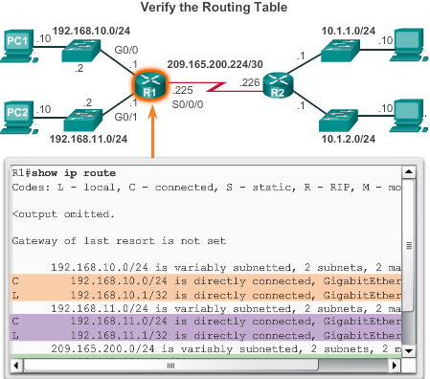
Verify Connectivity of Directly Connected Networks Verify Interface Settings
Show commands to verify operation and configuration of interface.
show ip interfaces brief
show ip route
show running-config
Show commands to gather more detailed interface information.
show interfaces
show ip interfaces
Notes:
4.1.4 Verify Connectivity of Directly Connected Networks
4.1.4.1 Verify Interface Settings

Slide 25
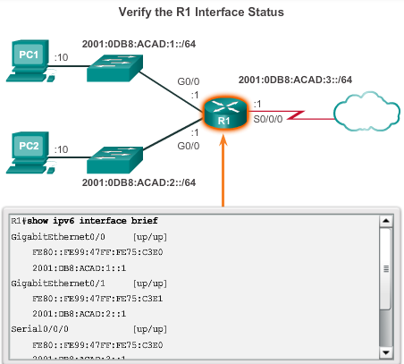
Verify Connectivity of Directly Connected Networks Verify Interface Settings
show ipv6 interface brief - displays a summary for each of the interfaces.
show ipv6 interface gigabitethernet 0/0 - displays the interface status and all the IPv6 addresses for this interface.
show ipv6 route - verify that IPv6 networks and specific IPv6 interface addresses have been installed in the IPv6 routing table.
show interface
show ipv6 routers
Notes:
4.1.4 Verify Connectivity of Directly Connected Networks
4.1.4.2.Verify IPv6 Interface Settings

Slide 26
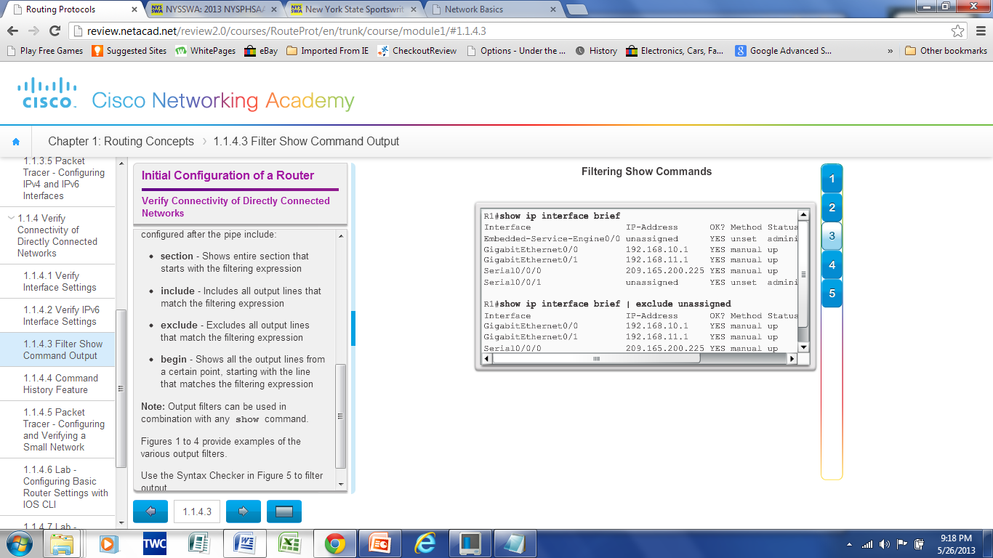
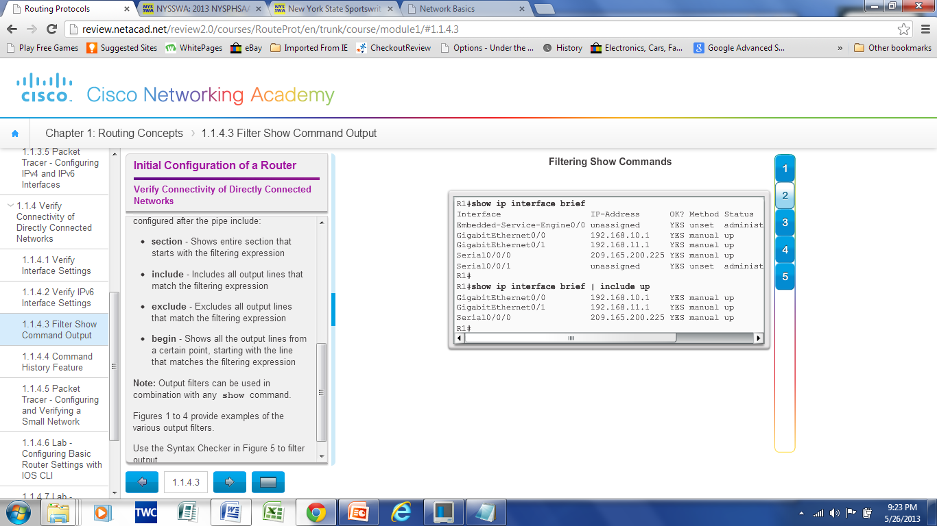
Verify Connectivity of Directly Connected Networks Filter Show Command Output
Use the terminal lengthnumbercommand to specify the number of lines to be displayed. A value of 0 (zero) prevents the router from pausing between screens of output.
To filter specific output of commands use the (|)pipe character after show command. Parameters that can be used after pipe include:
section, include, exclude, begin
Notes:
4.1.4 Verify Connectivity of Directly Connected Networks
4.1.4.3 Filter Show Command Output

Slide 27
Verify Connectivity of Directly Connected Networks Command History Feature
Recall commands – Ctrl+P or the UP Arrow
To return to more recent commands –Ctrl+N or Down Arrow
Command history is enabled and captures the last 10 commands in buffer – show history displays contents
Use terminal history size to increase or decrease size of the buffer.
Notes:
4.1.4 Verify Connectivity of Directly Connected Networks
4.1.4.4 Command History Feature
4.1.4.5 Packet Tracer – Configuring and Verifying a Small Network
4.1.4.6 Lab – Configuring Basic Router Settings with IOS CLI
4.1.4.7 Lab – Configuring Basic Router Settings with CCP

Slide 28
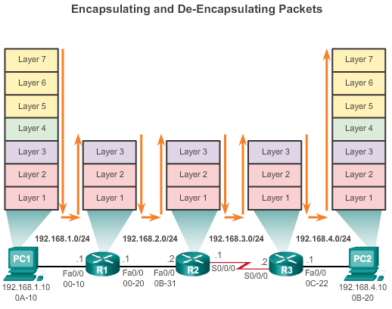
Switching Packets between Networks Router Switching Functions
Notes:
4.2.1 Switching Packets between Networks
4.2.1.1 Router Switching Functions

Slide 29
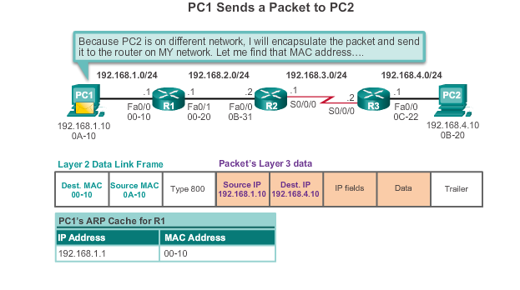
Switching Packets between Networks Send a Packet
Notes:
4.2.1 Switching Packets between Networks
4.2.1.2 Send a Packet

Slide 30
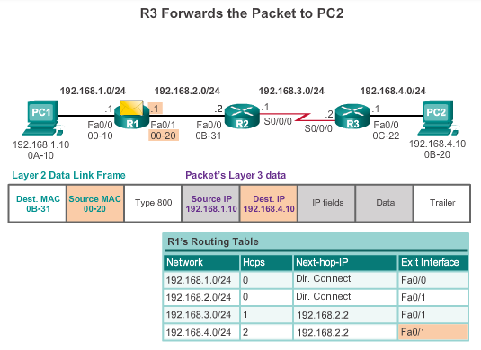
Switching Packets between Networks Forward to the Next Hop
Notes:
4.2.1 Switching Packets between Networks
4.2.1.3 Forward to the Next Hop

Slide 31
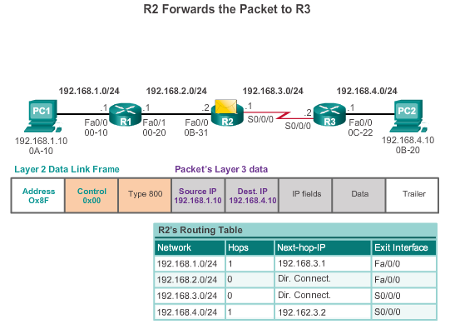
Switching Packets between Networks Packet Routing
Notes:
4.2.1 Switching Packets between Networks
4.2.1.4 Packet Routing

Slide 32
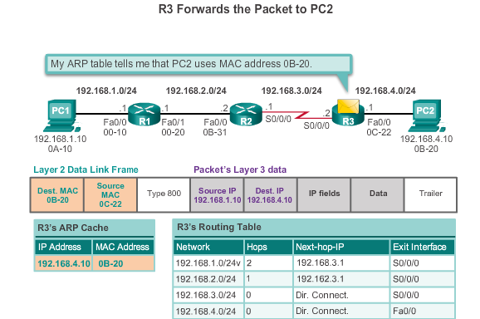
Switching Packets between Networks Reach the Destination
Notes:
4.2.1 Switching Packets between Networks
4.2.1.5 Reach the Destination
4.2.1.6 Activity – Match Layer 2 and Layer 3 Addressing

Slide 33
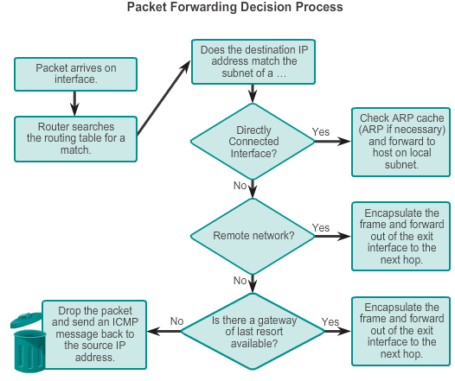
Path Determination Routing Decisions
Notes:
4.2.2 Path Determination
4.2.2.1 Routing Decisions

Slide 34
Path Determination Best Path
Best path is selected by a routing protocol based on the value or metric it uses to determine the distance to reach a network.
A metric is the value used to measure the distance to a given network.
Best path to a network is the path with the lowest metric.
Dynamic routing protocols use their own rules and metrics to build and update routing tables for example: Routing Information Protocol (RIP) - Hop count
Open Shortest Path First (OSPF) - Cost based on cumulative bandwidth from source to destination
Enhanced Interior Gateway Routing Protocol (EIGRP) - Bandwidth, delay, load, reliability
Open Shortest Path First (OSPF) - Cost based on cumulative bandwidth from source to destination
Enhanced Interior Gateway Routing Protocol (EIGRP) - Bandwidth, delay, load, reliability
.
Notes:
4.2.2 Path Determination
4.2.2.2 Best Path

Slide 35
Path Determination Load Balancing
When a router has two or more paths to a destination with equal cost metrics, then the router forwards the packets using both paths equally.
Notes:
4.2.2 Path Determination
4.2.2.3 Load Balancing

Slide 36
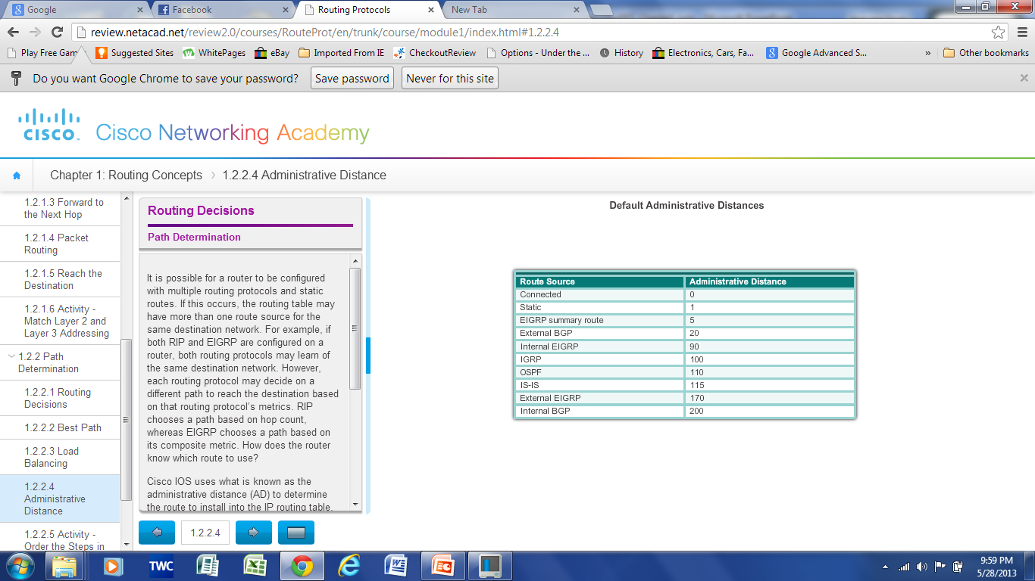
Path Determination of the route Administrative Distance
If multiple paths to a destination are configured on a router, the path installed in the routing table is the one with the best Administrative Distance (AD).
Administrative Distance is the “trustworthiness”
The Lower the AD the more trustworthy the route.
Notes:
4.2.2 Path Determination
4.2.2.4 Administrative Distance

Slide 37
Path Determination of the route Administrative Distance
If multiple paths to a destination are configured on a router, the path installed in the routing table is the one with the best (lowest) Administrative Distance (AD).
Administrative Distance is the “trustworthiness” of the route
The Lower the AD the more trustworthy the route.
Notes:
4.2.2 Path Determination
4.2.2.4 Administrative Distance
4.2.2.5 Activity – Order the Steps in the Packet Forwarding Process

Slide 38
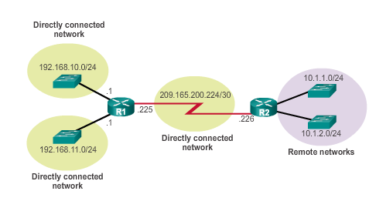
The Routing Table The Routing Table
Routing Table is a file stored in RAM that contains information about
Directly Connected Routes
Remote Routes
Network or Next hop Associations
Notes:
4.3 Router Operation
4.3.1 Analyze the Routing Table
4.3.1.1 The Routing Table

Slide 39
The Routing Table Routing Table Sources
Show ip route command is used to display the contents of the routing table
Link local Interfaces –Added to the routing table when an interface is configured. (displayed in IOS 15 or newer)
Directly connected interfaces -Added to the routing table when an interface is configured and active.
Static routes - Added when a route is manually configured and the exit interface is active.
Dynamic routing protocol - Added when EIGRP or OSPF are implemented and networks are identified.
Notes:
4.3 Router Operation
4.3.1 Analyze the Routing Table
4.3.1.2 Routing Table Sources

Slide 40
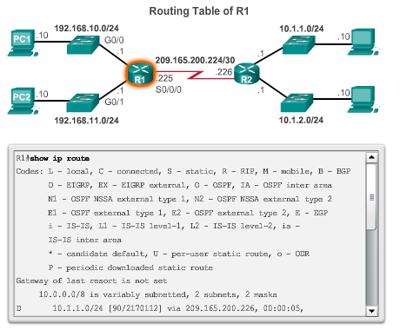
The Routing Table Routing Table Sources
Notes:
4.3 Router Operation
4.3.1 Analyze the Routing Table
4.3.1.2 Routing Table Sources

Slide 41
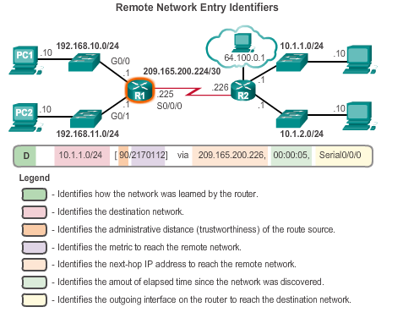
The Routing Table Remote Network Routing Entries
Interpreting the entries in the routing table.
Notes:
4.3 Router Operation
4.3.1 Analyze the Routing Table
4.3.1.3 Remote Network Routing Entries
4.3.1.4 Activity- Interpret the Content of a Routing Table Entry

Slide 42
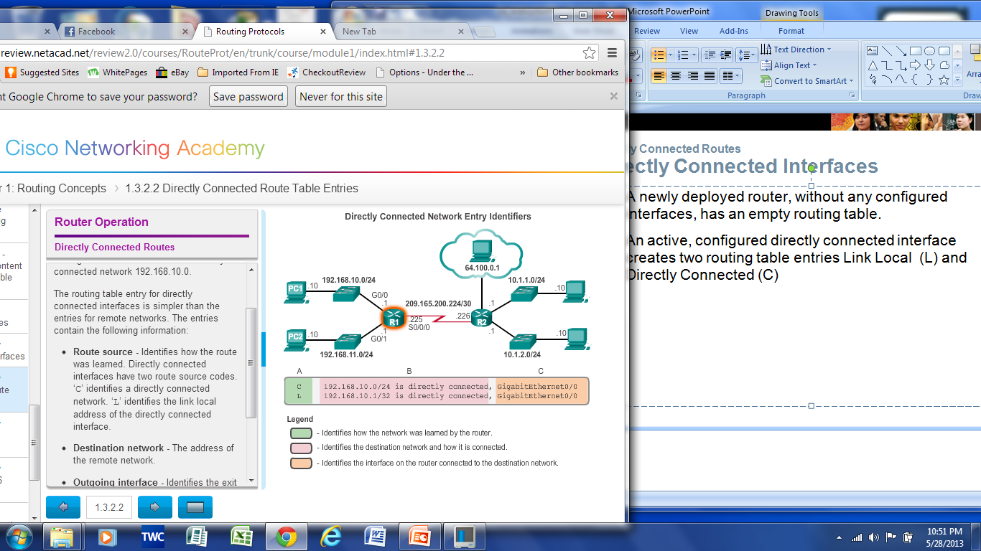
Directly Connected Routes Directly Connected Interfaces
A newly deployed router, without any configured interfaces, has an empty routing table.
An active, configured directly connected interface creates two routing table entries Link Local (L) and Directly Connected (C)
Notes:
4.3 Router Operation
4.3.2 Directly Connected Routes
4.3.2.1 Directly Connected Interfaces
4.3.2.2 Directly Connected Route Table Entries

Slide 43
Directly Connected Routes Directly Connected Interfaces
A newly deployed router, without any configured interfaces, has an empty routing table.
An active, configured directly connected interface creates two routing table entries Link Local (L) and Directly Connected (C)
Notes:
4.3 Router Operation
4.3.2 Directly Connected Routes
4.3.2.1 Directly Connected Interfaces
4.3.2.2 Directly Connected Route Table Entries

Slide 44
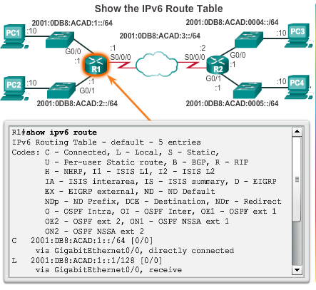
Directly Connected Routes Directly Connected IPv6 Example
The show ipv6 route command shows the ipv6 networks and routes installed in the routing table
Notes:
4.3 Router Operation
4.3.2 Directly Connected Routes
4.3.2.4 Directly Connected IPv6 Example
4.3.2.5 Packet Tracer – Investigating Directly Connected Routes

Slide 45
Statically Learned Routes Static Routes
Manually configured
Define an explicit path between two networking devices.
Must be manually updated if the topology changes.
Benefits include improved security and control of resources.
Static route to a specific network.
ip routenetworkmask {next-hop-ip | exit-intf}
Default Static Route used when the routing table does not contain a path for a destination network.
ip route 0.0.0.0 0.0.0.0 {exit-intf | next-hop-ip
Notes:
4.3 Router Operation
4.3.3 Statically Learned Routes
4.3.3.1 Static Routes

Slide 46
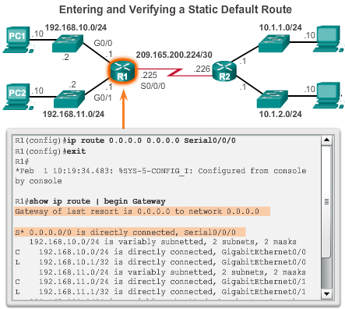
Statically Learned Routes Static Routes Example
Notes:
4.3 Router Operation
4.3.3 Statically Learned Routes
4.3.3.2 Static Routes Examples

Slide 47
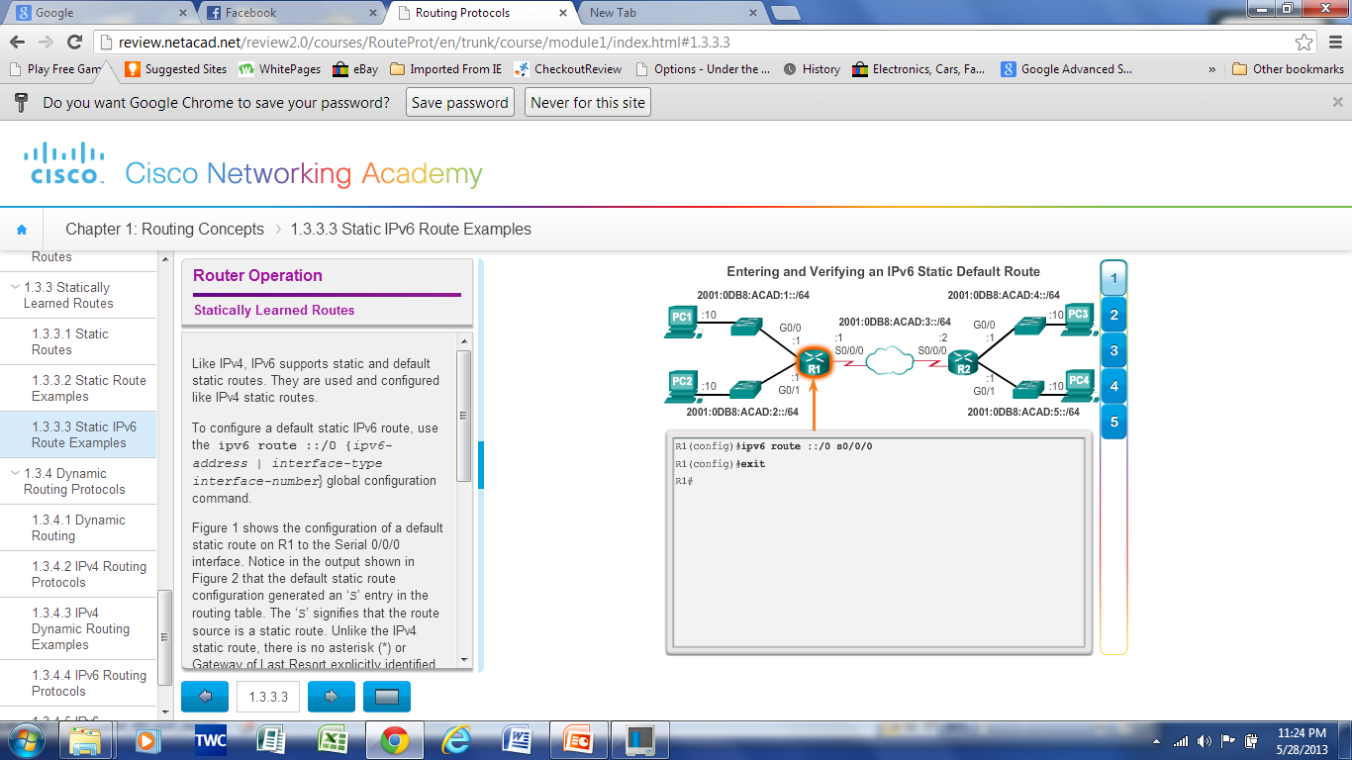
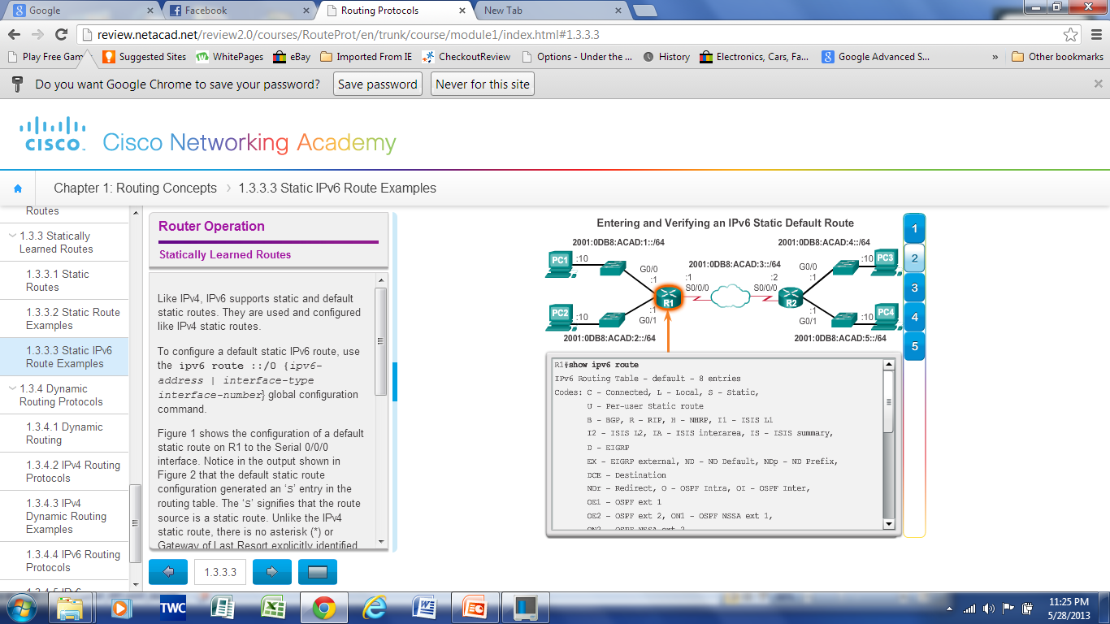
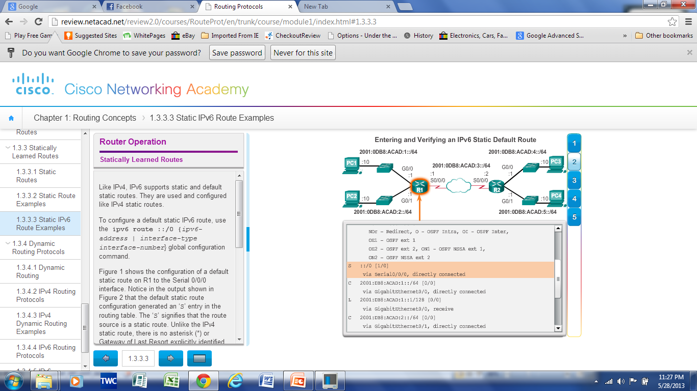
Statically Learned Routes Static IPv6 Routes Example
Notes:
4.3 Router Operation
4.3.3 Statically Learned Routes
4.3.3.3 Static IPv6 Route Example

Slide 48
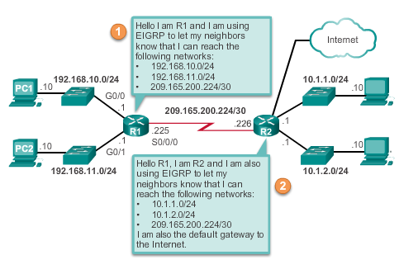
Dynamic Routing Protocols Dynamic Routing
Used by routers to share information about the reachability and status of remote networks.
Performs network discovery and maintaining routing tables.
Notes:
4.3 Router Operation
4.3.4 Dynamic Routing Protocols
4.3.4.1 Dynamic Routing

Slide 49
Dynamic Routing Protocols IPv4 Routing Protocols
Cisco ISR routers can support a variety of dynamic IPv4 routing protocols including:
EIGRP – Enhanced Interior Gateway Routing Protocol
OSPF – Open Shortest Path First
IS-IS – Intermediate System-to-Intermediate System
RIP – Routing Information Protocol
Notes:
4.3 Router Operation
4.3.4 Dynamic Routing Protocols
4.3.4.2 IPv4 Routing Protocols

Slide 50
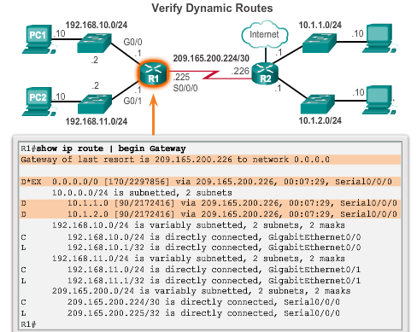
Dynamic Routing Protocols IPv4 Routing Protocols
Notes:
4.3 Router Operation
4.3.4 Dynamic Routing Protocols
4.3.4.3 IPv4 Routing Protocols Example

Slide 51
Dynamic Routing Protocols IPv6 Routing Protocols
Cisco ISR routers can support a variety of dynamic IPv6 routing protocols including:
RIPng (RIP next generation)
OSPF v3
EIGRP for IPv6
MP-BGP4 (Multicast Protocol-Border Gateway Protocol)
Notes:
4.3 Router Operation
4.3.4 Dynamic Routing Protocols
4.3.4.4 IPv6 Routing Protocols

Slide 52
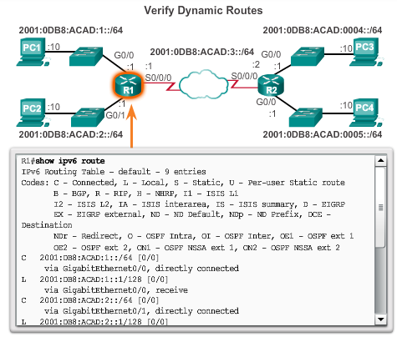
Dynamic Routing Protocols IPv6 Routing Protocols
Notes:
4.3 Router Operation
4.3.4 Dynamic Routing Protocols
4.3.4.5 IPv6 Routing Protocols Example

Slide 53
Chapter 4: Summary
Notes:
Chapter 4 Summary

Slide 54


